Slide 1
Unit Testing
Breaking it down

Slide 2
Rules
Don’t take what I say for granted
Think about it
Participate
BTW, I’m not a unit testing expert
Notes:
Please don’t blindly accept what I say as true (however, don’t dismiss it blindly either)
If something I say seems off-kilter, it’s your responsibility to bring up the discussion point. If you don’t all of your colleagues will now have the wrong idea about something that you could’ve fixed.
This will be a lot better for you and me if you all participate.
Most of the things I’m going to show, while they may be corollary to .NET programming, are just as relevant in any other platform.
Also, try not to get hung up on any given tooling. Clear your mind of any connotations you may have associated with xUnit patterns or xUnit tools (Nunit, MSTest, etc.)
Basically, try not to limit your understanding and thinking based on any toolset.

Slide 3
Experience?
?
Notes:
Just to get a feel, what experience do you guys have unit testing, tools, mocking, etc?

Slide 4
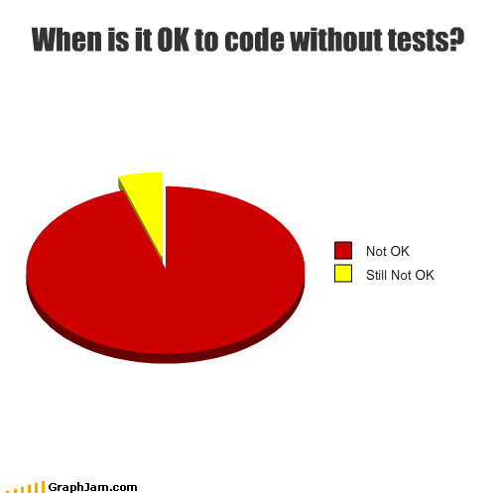

Slide 5
Why
Naming
Implementation
Style
Organization
Tools

Slide 6
Why do we care about unit testing?
Notes:
Maintainability
Design – Testability leads to lower coupling and higher cohesion
Quality
Proof
---
If it’s difficult to test, it’ll most likely be difficult to use in your application

Slide 7
Naming
Notes:
Naming unit tests is an art (and probably some science too).
It’s usually difficult (for me) to express my intent the way I would like.
It’s extremely important for our tests to be named well so you can come back later and know EXACTLY what a test is doing VERY quickly.
------
What are some good qualities a well-named unit test (it’s okay if some traits are contradictory)?
-------
Clear
Concise
Verbose
Descriptive

Slide 8
ShouldExecuteCorrectly
Naming
Notes:
What’s wrong with this name?
Context?
I wonder what ‘correct’ means
I wonder what ‘execute’ means

Slide 9
ShouldUpdateCustomerName
Naming
Notes:
What is wrong with this one?
Sound’s okay.
Short.
But we don’t have any context (when/why should it update the customer name).

Slide 10
ShouldUpdateCustomerNameToFredWhenChangingCustomerDetailsFromBobToFred
Naming

Slide 11
ShouldUpdateCustomerNameWhenChangingCustomerDetails
Naming

Slide 12
Implementation
Notes:
Cool, so we can write good names.
Once we have named our test, what makes a good test?
----
Repeatable
Explainable
Simple
Singular
One-Logical Assert
Positive
Negative
Boundary Conditions and Corner Cases
Readable
Robust
Not Fragile/Brittle
Not necessarily complete DRY

Slide 13
Examples…

Slide 14
Implementation Anti-patterns
Notes:
Can you think of any off the top of your head?
-----
Subclass and override (breaks encapsulation)
Hard and fast rules (e.g. EVERY test must start with Should or EVERY test must have an assertion message)
Testing private methods
The “Everything Test”

Slide 15
Examples…

Slide 16
Style
Notes:
We’ll talk about a couple different styles of tests… a couple of which you’re probably already familiar with, and one maybe not

Slide 17
State Based
Style – State Based
Notes:
So you’re familiar with this one, right?
You’ve got inputs, and you’ve got outputs, and you make sure they are what you expect.

Slide 18
Examples…
Style – State Based
Notes:
Mention AAA

Slide 19
Interaction Based
Style – State Based
Notes:
So these types of tests verify some kind of behavior and interaction among the system under test and a collaborator.
We’ll talk about the word “Test Double” here. A test double is any object that is used in place of a real object (sort of like a stunt double).
Doubles: Dummy, Fake, Stub, Mock
It’s easy to assume we always want mocks, but that can lead to brittle tests.

Slide 20
Examples… stub
Style – Interaction Based

Slide 21
Examples… mock
Style – Interaction Based

Slide 22
Interaction Anti-Patterns
Style – Interaction Based
Notes:
Can you think of any interaction style anti-patterns?
---
Mocking when all you want is stub
VerifyAll
Setting expectations on things that you aren’t really verifying (setting an expectation is the equivalent of an assert… remember, one per test)
A chatty interface can lead to very brittle tests
Not using a mocking framework
----
Rule:
Verify only the things you care about

Slide 23
BDD
Style – BDD
Notes:
We’re not going to go into a ton of detail with this, just a cursory look so you’ve seen it, and so your brain can start working on it.
Instead of having a test class per class, BDD groups tests into behaviors and contexts, so you may end up with multiple behaviors per class.
Rspec is a very popular tool in ruby (and is starting to be in .NET too), so we’ll look at it briefly.

Slide 24
RSPEC example
Style – BDD

Slide 25
Organization
Notes:
Why is test organization important?
Productivity, Completeness, streamlining
-------------
What are some ways you’ve organized tests on previous projects? Or some ways you can think of that might prove more useful
Project structure
Speed
Style (state based vs interaction)
Type (functional, end-to-end, integration acceptance)
Functional Area
Component Area
Build Area (for build-pipelines)
----
BDD has some built-in organizational characteristics, grouped by

Slide 26
Tools
Notes:
Arguably my favorite part…
What tools have you used?
.NET: Nunit, xunit.net, mspec, moq, rhino, r#, TD.NET, Autotest for .NET, white
Ruby: rspec, cucumber, autotest

Slide 27
Resources
http://martinfowler.com/articles/mocksArentStubs.html

